Slide 1
COLOR OF THE YEAR: VERY PERI PORTFOLIO
JAN 2022
NEXT
Here is where your presentation begins

Slide 2
CONTENTS OF THIS TEMPLATE
BACK
HOME
NEXT
Here’s what you’ll find in this Slidesgo template:
A slide structure based on a portfolio, which you can easily adapt to your needs. For more info on how to edit the template, please visit Slidesgo School or read our FAQs.
To view this template with the correct fonts in ppt format, download and install on your computer the fonts that we have used. You can learn how to download and install fonts here.
An assortment of graphic resources that are suitable for use in the presentation can be found in the alternative resources slides.
A thanks slide, which you must keep so that proper credits for our design are given.
Two resources slides, where you’ll find links to all the elements used in the template.
Instructions for use.
Final slides with:
The fonts and colors used in the template.
A selection of illustrations. You can also customize and animate them as you wish with the online editor. Visit Storyset to find more.
More infographic resources, whose size and color can be edited.
Sets of customizable icons of the following themes: general, business, avatar, creative process, education, help & support, medical, nature, performing arts, SEO & marketing, and teamwork.
You can delete this slide when you’re done editing the presentation.

Slide 3
TABLE OF CONTENTS
01
02
ABOUT ME
WHAT I DO
03
04
MY EXPERIENCE
MY WORK
BACK
HOME
NEXT
You can describe the topic of the section here
You can describe the topic of the section here
You can describe the topic of the section here
You can describe the topic of the section here

Slide 4
TABLE OF CONTENTS
01
04
ABOUT ME
MY WORK
02
05
WHAT I DO
REFERENCES
03
06
MY EXPERIENCE
OTHER PROJECTS
BACK
HOME
NEXT
You can describe the topic of the section here
You can describe the topic of the section here
You can describe the topic of the section here
You can describe the topic of the section here
You can describe the topic of the section here
You can describe the topic of the section here

Slide 5
INTRODUCTION
BACK
HOME
NEXT
You can give a brief description of the topic you want to talk about here. For example, if you want to talk about Mercury, you can say that it’s the smallest planet in the entire Solar System

Slide 6
01
ABOUT ME
BACK
HOME
NEXT
You can enter a subtitle here if you need it

Slide 7
ABOUT ME
BACK
HOME
NEXT
You can give a brief description of the topic you want to talk about here. For example, if you want to talk about Mercury, you can say that it’s the smallest planet in the entire Solar System

Slide 8

ABOUT ME
BACK
HOME
NEXT
JENNA DOE
Despite being red, Mars is actually a cold place. It's full of iron oxide dust, which gives the planet its reddish cast
+91 620 421 838
yourwebsite.com
addyouremail@freepik.com

Slide 9
VALUES
VENUS
EARTH
MARS
BACK
HOME
NEXT
Venus is the second planet from the Sun
Earth is the third planet from the Sun
Despite being red, Mars is actually a cold place

Slide 10
WHAT DO I DO?
BACK
HOME
NEXT
VENUS
SATURN
Despite being red, Mars is actually a cold place. It’s full of iron oxide dust
Venus has a beautiful name and is the second planet from the Sun. It’s terribly hot

Slide 11

WHAT DO I DO?
BACK
HOME
NEXT
VENUS
Venus is the second planet from the Sun
SATURN
It’s composed of hydrogen and helium
MARS
Despite being red, Mars is a cold place

Slide 12

A PICTURE IS WORTH A THOUSAND WORDS
BACK
HOME
NEXT

Slide 13
MY RESUME
BACK
HOME
NEXT
EXPERIENCE
EDUCATION
2021
Your position here Company name here
4 years
Your studies here Institution name here
6 years
Your studies here Institution name here
2019
Your position here Company name here
SKILLS
2012
Your position here Company name here
2003
Your position here Company name here
Design
Production
Photography

Slide 14
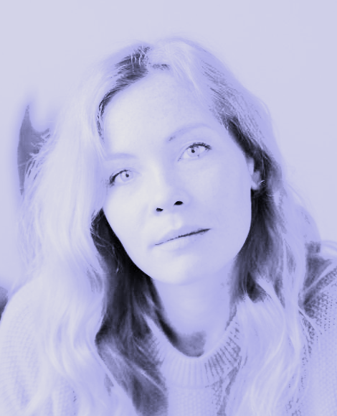
MY RESUME
BACK
HOME
NEXT
THIS IS ME
MY SKILLS
AGE
SKILL 1
30
Venus is a hot planet
LOCATION
SKILL 2
Madrid (Spain)
Mercury is very small
MY INTERESTS
SKILL 2
3/5
4/5
Mars is a red planet

Slide 15
02
WHAT I DO
BACK
HOME
NEXT
You can enter a subtitle here if you need it

Slide 16
—SOMEONE FAMOUS
BACK
HOME
NEXT
“This is a quote, words full of wisdom that someone important said and can make the reader get inspired.”

Slide 17
MY AREAS OF EXPERTISE
20%
30%
50%
MERCURY
VENUS
MARS
BACK
HOME
NEXT
It’s the closest planet to the Sun and the smallest in the Solar System
Venus has a beautiful name and is the second planet from the Sun
Despite being red, Mars is actually a cold place. It’s full of iron oxide dust

Slide 18
MY VALUES
BACK
HOME
NEXT
EARTH | MARS | JUPITER | VENUS
Earth is the planet with life | Mars is made of basalt | Mercury is a small planet | Saturn is the ringed planet
Venus is extremely hot | Jupiter is the biggest planet | Neptune is far away from us | Pluto is now a dwarf planet
80%
90%
50%
30%

Slide 19
IMPORTANT FACTS ABOUT MY WORK
BACK
HOME
NEXT
WORK 1
WORK 2
Name some important facts about your work
Name some important facts about your work
Name some important facts about your work
Name some important facts about your work
Name some important facts about your work
Name some important facts about your work

Slide 20
MY VALUES
SATURN
MARS
VENUS
JUPITER
BACK
HOME
NEXT
Saturn is a gas giant and has several rings
Despite being red, Mars is a cold place
Venus is the second planet from the Sun
It’s the biggest planet in the Solar System

Slide 21
MY MAIN SKILLS
SKILL 1
70%
SKILL 2
50%
SKILL 3
35%
BACK
HOME
NEXT
Venus is the second planet from the Sun
Despite being red, Mars is a cold place
Jupiter is the biggest planet of them all

Slide 22
AWESOME WORDS
BACK
HOME
NEXT

Slide 23
MORE AWESOME WORDS
BACK
HOME
NEXT

Slide 24
03
MY EXPERIENCE
BACK
HOME
NEXT
You can enter a subtitle here if you need it

Slide 25
WHERE I HAVE WORKED
BACK
HOME
NEXT
JOB 1
Mars is actually a very cold place
JOB 2
Venus is the second planet from the Sun

Slide 26
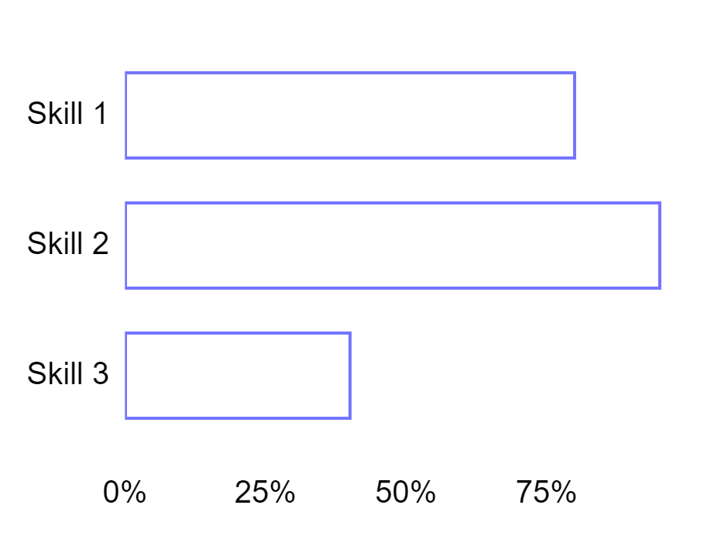
MY SKILLS
BACK
HOME
NEXT
80%
SKILL 1
Jupiter is the biggest planet of them all
95%
SKILL 2
Mars is actually a very cold place
40%
SKILL 3
Follow the link in the graph to modify its data and then paste the new one here. For more info, click here
Neptune is the farthest planet from the Sun

Slide 27
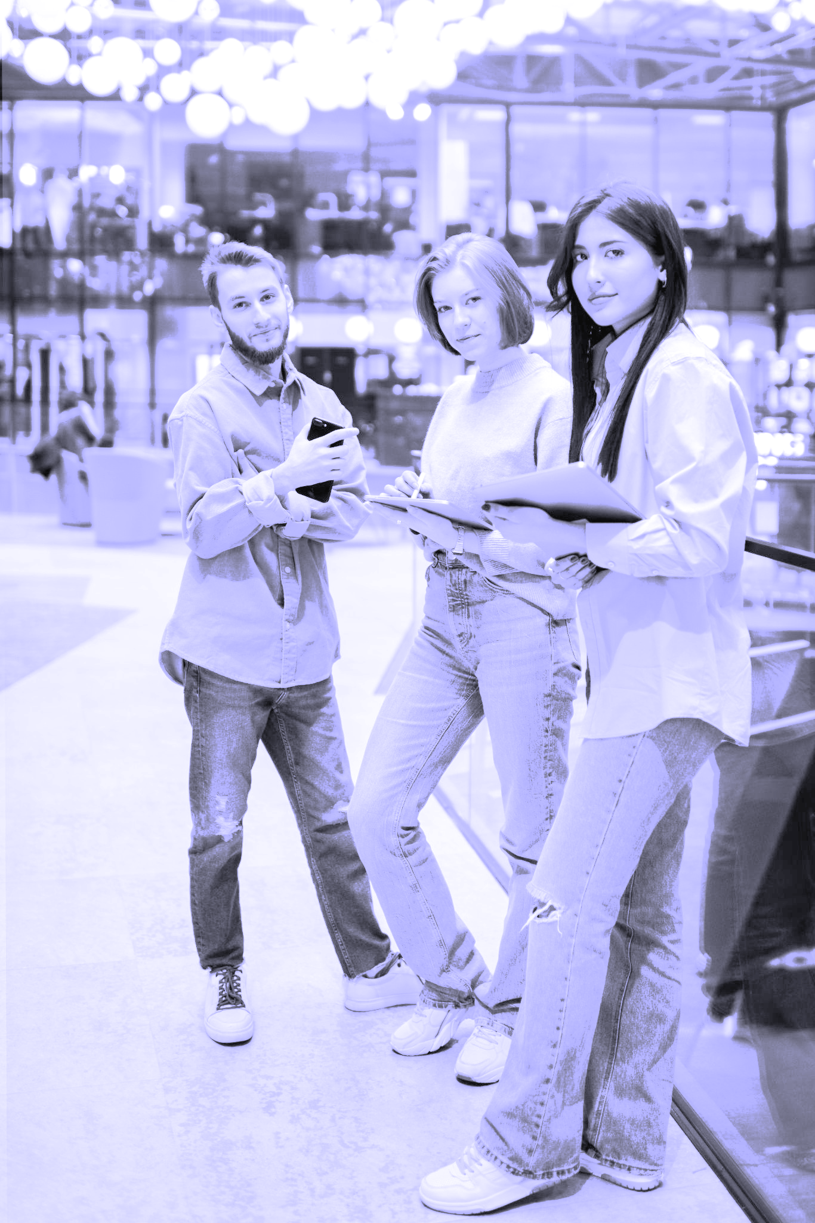

THIS IS WHOM I WORKED WITH
BACK
HOME
NEXT
TEAM 1
Despite being red, Mars is actually a cold place. It’s full of iron oxide dust
TEAM 2
Venus has a beautiful name and is the second planet from the Sun

Slide 28
MY EDUCATION
BACK
HOME
NEXT
2013-2015
STUDY 2
2019-2021
You can describe the study here
You can describe the study here
You can describe the study here
STUDY 1
2015-2019
STUDY 3

Slide 29
TO SUM UP
BACK
HOME
NEXT
 | PROJECT 01 | PROJECT 02 | PROJECT 03
YEAR | 2010 | 2015 | 2020
AREA | Venus has a beautiful name | Jupiter is the biggest planet | Neptune is very far from the Sun
BUSINESS | Mention the name of the company | Mention the name of the company | Mention the name of the company
POSITION | Describe your work and experience here | Describe your work and experience here | Describe your work and experience here

Slide 30
PROJECTS COMPARISON
BACK
HOME
NEXT
 | MERCURY | VENUS | MARS
PROJECT 1
PROJECT 2
PROJECT 3

Slide 31
04
MY WORK
BACK
HOME
NEXT
You can enter a subtitle here if you need it

Slide 32
MY WORK - AREA #1
BACK
HOME
NEXT
You can enter a subtitle here if you need it

Slide 33
PROJECT EVOLUTION
BACK
HOME
NEXT
2019
EARTH
2021
JUPITER
Earth is a planet that harbors life
Jupiter is the biggest planet
2020
MARS
2022
SATURN
Mars is actually a very cold place
Saturn has several rings

Slide 34
PROJECT 1
MERCURY
VENUS
EARTH
MARS
BACK
HOME
NEXT
Mercury is the closest planet to the Sun
Venus is the second planet from the Sun
Earth is the third planet from the Sun
Despite being red, Mars is actually a cold place

Slide 35
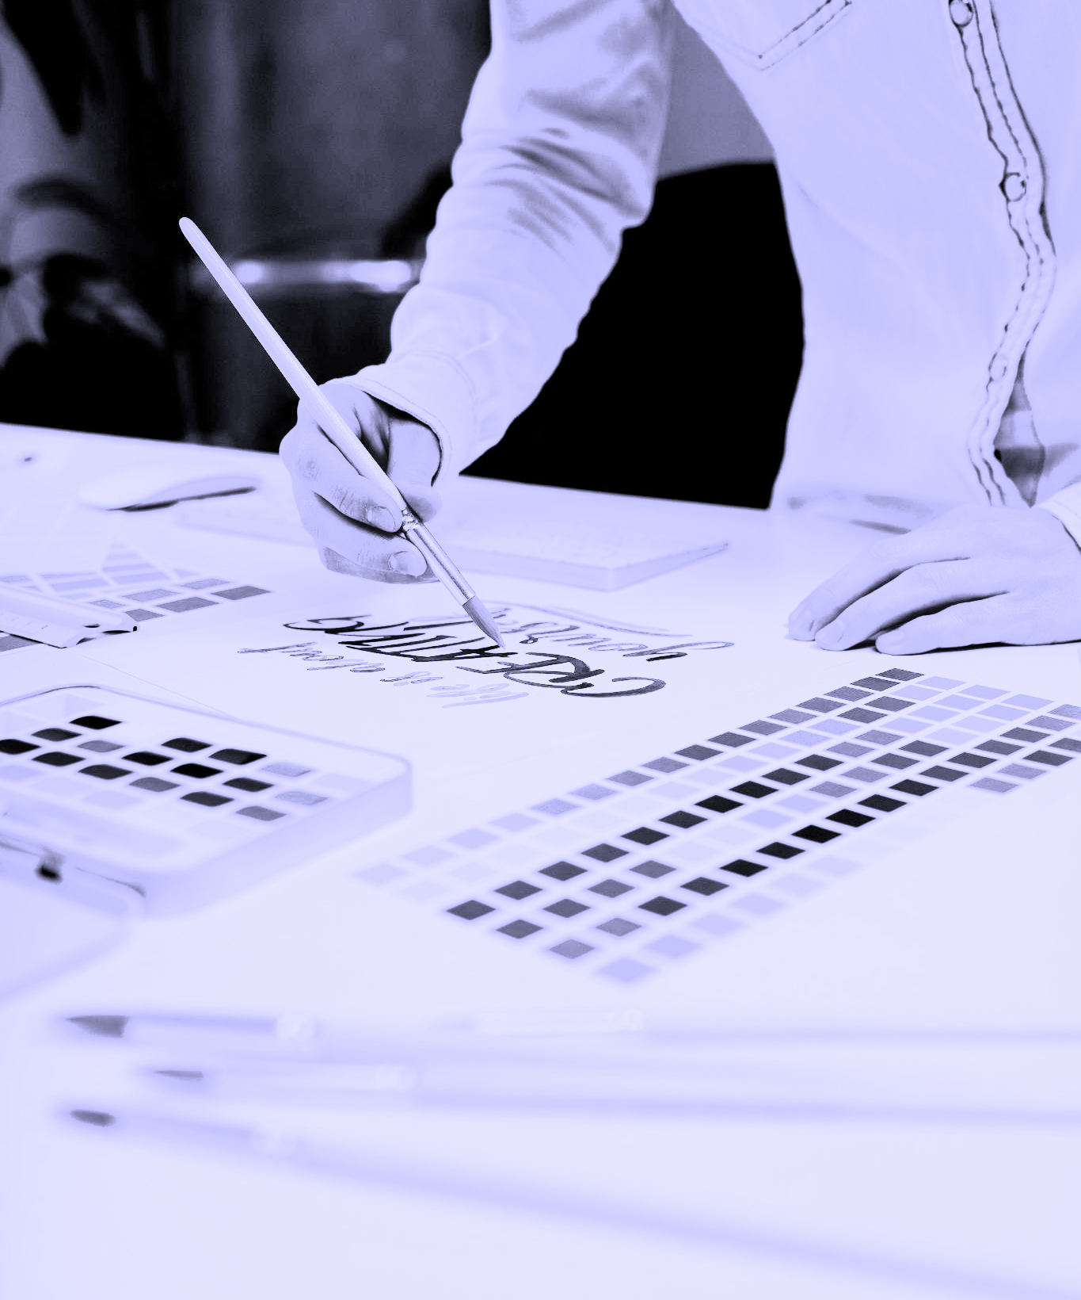
PROJECT 1
BACK
HOME
NEXT
TITLE OF THE PROJECT
Saturn is a gas giant and has several rings. It's composed mostly of hydrogen and helium. It was named after the Roman god of wealth and agriculture
VENUS
Venus is the second planet from the Sun
MARS
Mars is full of iron oxide dust

Slide 36
ABOUT MY AREAS OF EXPERTISE
BACK
HOME
NEXT
Do you know what helps you make your point crystal clear?
Lists like this one:
They’re simple
You can organize your ideas clearly
You’ll never forget to buy milk!
And the most important thing: the audience won’t miss the point of your presentation

Slide 37

A PICTURE REINFORCES THE CONCEPT
BACK
HOME
NEXT
Images reveal large amounts of data, so remember: use an image instead of a long text. Your audience will appreciate it

Slide 38
MY METHODOLOGY
BACK
HOME
NEXT
JUPITER
VENUS
Jupiter is a gas giant and the biggest planet
Venus is the second planet from the Sun
MERCURY
MARS
Mercury is the closest planet to the Sun
Despite being red, Mars is a cold place

Slide 39
MY WORK - AREA #2
BACK
HOME
NEXT
You can enter a subtitle here if you need it

Slide 40
PROJECT 2
STEP 1
STEP 2
STEP 3
STEP 4
STEP 5
STEP 6
BACK
HOME
NEXT
Jupiter is a gas giant and the biggest planet
Saturn is a gas giant and has several rings
Neptune is the farthest planet from the Sun
The Sun is the star at the center of the Solar System
Pluto is considered a dwarf planet
The Moon is Earth’s only natural satellite

Slide 41
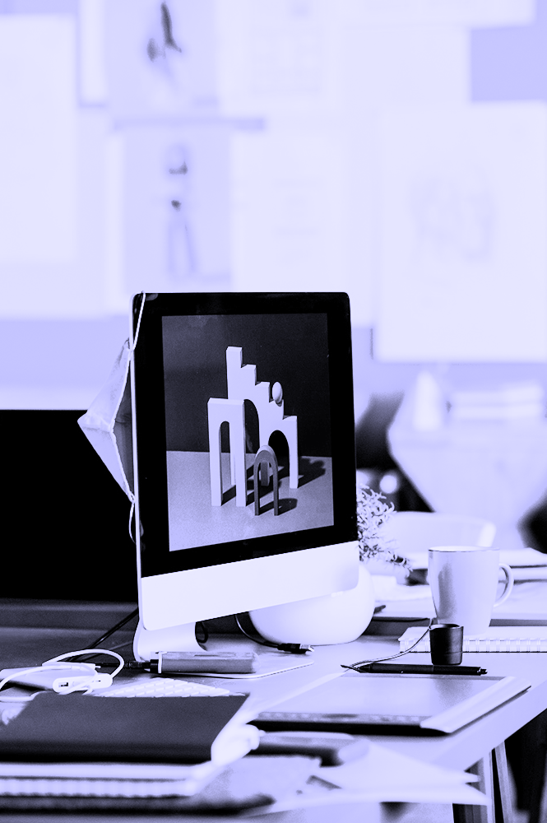
PROJECT 2
BACK
HOME
NEXT
TITLE OF THE PROJECT
Saturn is a gas giant and has several rings. It's composed mostly of hydrogen and helium. It was named after the Roman god of wealth and agriculture
GOALS OF THE PROJECT
Despite being red, Mars is very cold
Jupiter is a gas giant and the biggest planet

Slide 42
PROJECT DEADLINES
BACK
HOME
NEXT
 | DESCRIPTION | CLIENT | DEADLINE | CHECK
TASK 1 | Mercury is a small planet | Jenna Doe | Fri, May 6
TASK 2 | Venus is a hot planet | Timmy Jimmy | Wed, June 22
TASK 3 | We all live on Earth | Sarah Miller | Thu, July 12
TASK 4 | Mars is made of basalt | James Williams | Mon, Sep 15

Slide 43
MY SCHEDULE
BACK
HOME
NEXT
SUN | MON | TUE | WED | THU | FRI | SAT
 | 1 | 2 | 3 | 4 | 5 | 6
7 | 8 | 9 | 10 | 11 | 12 | 13
14 | 15 | 16 | 17 | 18 | 19 | 20
21 | 22 | 23 | 24 | 25 | 26 | 27
28 | 29 | 30 | 31
SUN 7
TUE 30
FRI 19
Mars is a cold planet
Jupiter is a gas giant
Venus is very hot

Slide 44
150,000
BACK
HOME
NEXT
Big numbers catch your audience’s attention

Slide 45
HOW DO I WORK?
01
02
03
JUPITER
VENUS
MARS
BACK
HOME
NEXT
Jupiter is the biggest planet of them all
Venus is the second planet from the Sun
Mars is actually a very cold place

Slide 46
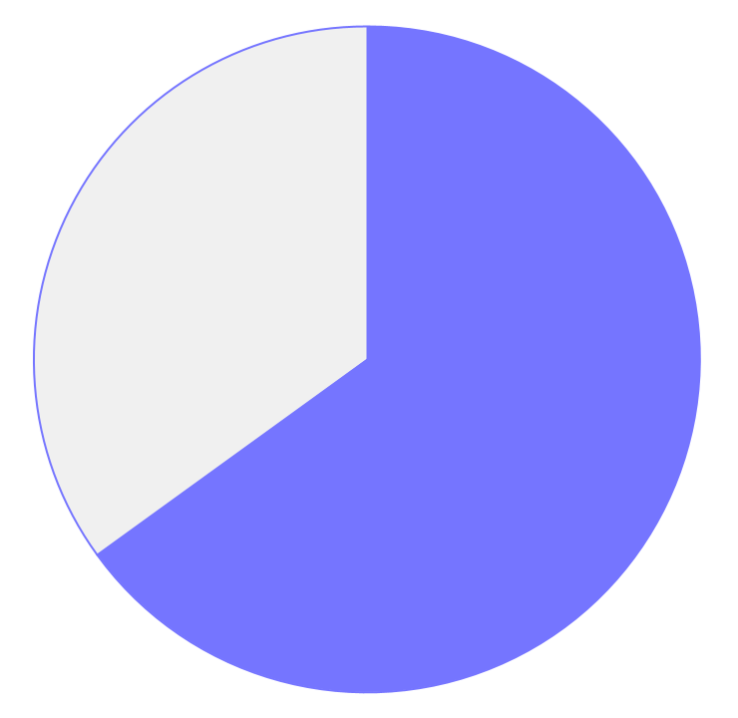
TIME SPENT IN MY PROJECTS
BACK
HOME
NEXT
35%
MERCURY
It’s the closest planet to the Sun
65%
JUPITER
Jupiter is the biggest planet of them all
Follow the link in the graph to modify its data and then paste the new one here. For more info, click here

Slide 47

TO REINFORCE THE CONCEPT, TRY USING AN IMAGE
BACK
HOME
NEXT
Images reveal large amounts of data, so remember: use an image instead of a long text. Your audience will appreciate it

Slide 48
BUDGET FOR MY PROJECTS
BACK
HOME
NEXT
 | MONTHLY PLAN | QTLY. PLAN | ANNUAL PLAN
PACK 1 | $19.95 | $39.95 | $59.95
PACK 2 | $29.95 | $49.95 | $69.95
PACK 3 | $39.95 | $59.95 | $79.00

Slide 49
25K
BACK
HOME
NEXT
Big numbers catch your audience’s attention

Slide 50
05
REFERENCES
BACK
HOME
NEXT
You can enter a subtitle here if you need it

Slide 51
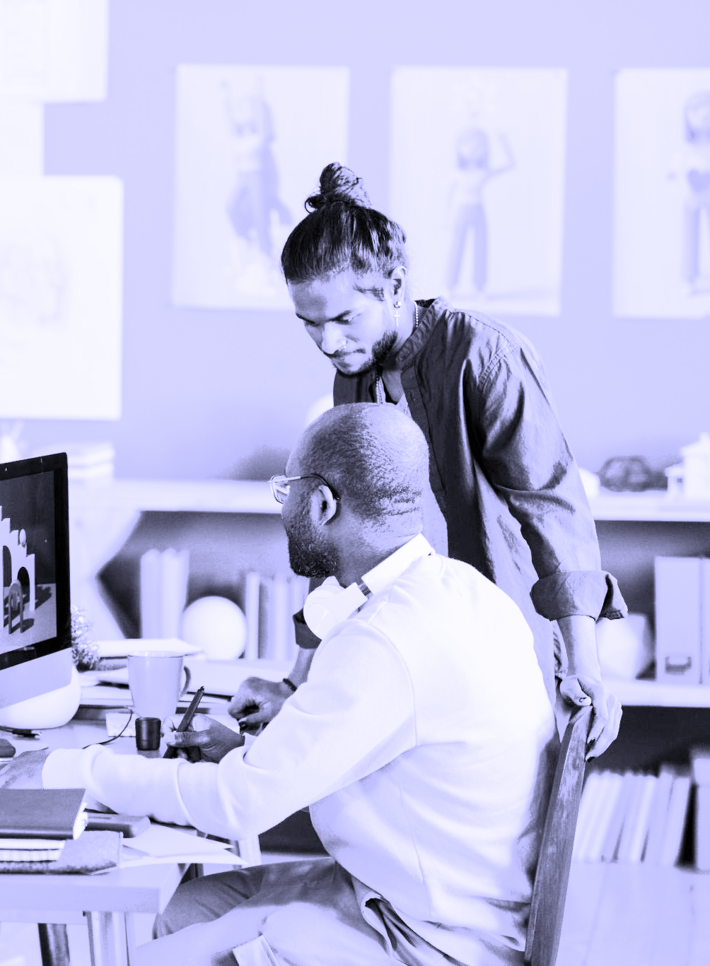
MY REFERENCES
BACK
HOME
NEXT
Do you know what helps you make your point crystal clear?
Lists like this one:
They’re simple
You can organize your ideas clearly
You’ll never forget to buy milk!
And the most important thing: the audience won’t miss the point of your presentation

Slide 52
INTERNATIONAL EXPERIENCE
BACK
HOME
NEXT
MARS
Mars is actually a very cold place
VENUS
Venus is the second planet from the Sun
SATURN
Jupiter is the biggest planet of them all

Slide 53
MY EXPERIENCE
BACK
HOME
NEXT
2003
2012
2019
2022
EARTH
MARS
JUPITER
SATURN
Earth is a planet that harbors life
Mars is actually a cold place
Jupiter is the biggest planet
Saturn has several rings

Slide 54
MY EXPERIENCE
BACK
HOME
NEXT
2001-2005
JOB 1
Mercury is the closest planet to the Sun
2005-2007
JOB 2
Venus is the second planet from the Sun
2007-2010
JOB 3
Mars is actually a very cold place
2010-2021
JOB 4
Jupiter doesn’t have a solid surface

Slide 55
OTHER PROJECTS
06
BACK
HOME
NEXT
You can enter a subtitle here if you need it

Slide 56
9h 55m 23s
333,000.000
386,000 km
BACK
HOME
NEXT
Jupiter's rotation period
The Sun’s mass compared to Earth’s
Distance between Earth and the Moon

Slide 57
OLD PROJECTS
MARS
JUPITER
MERCURY
NEPTUNE
VENUS
SATURN
BACK
HOME
NEXT
Despite being red, Mars is a cold place
Jupiter is the biggest planet of them all
Mercury is the closest planet to the Sun
Neptune is the farthest planet from the Sun
Venus is the second planet from the Sun
It’s composed of hydrogen and helium

Slide 58
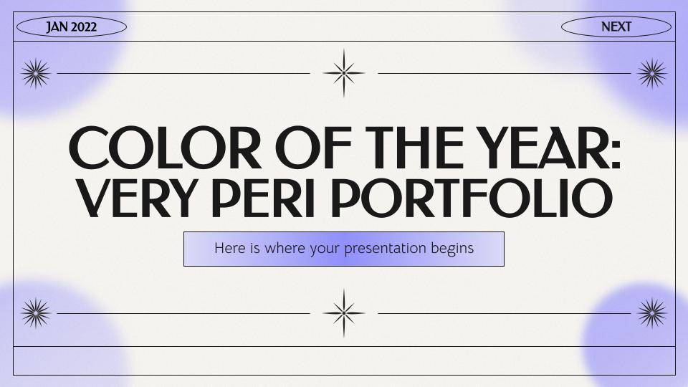
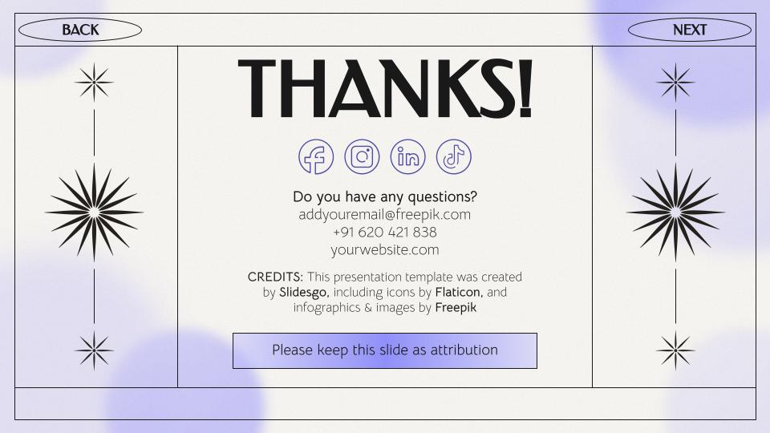
TWO MOCKUPS
BACK
HOME
NEXT
You can replace the images on the screens with your own work. Just right-click on them and select “Replace image”

Slide 59
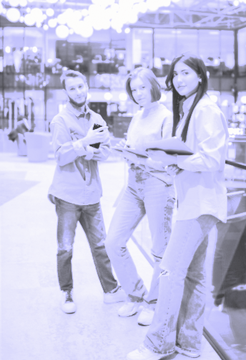
TABLET MOCKUP
BACK
HOME
NEXT
You can replace the images on the screens with your own work. Just right-click on them and select “Replace image”

Slide 60
THANKS!
BACK
HOME
NEXT
Do you have any questions?
addyouremail@freepik.com
+91 620 421 838
yourwebsite.com
Please keep this slide as attribution

Slide 61
ICON PACK: JOB RESUME
BACK
HOME
NEXT

Slide 62
PREMIUM ICON PACK: DESIGN
BACK
HOME
NEXT

Slide 63
ALTERNATIVE RESOURCES
BACK
HOME
NEXT

Slide 64
PREMIUM ALTERNATIVE RESOURCES
BACK
HOME
NEXT
Here’s an assortment of alternative resources whose style fits that of this template:
PHOTOS
Logo designer working on her tablet connected to a laptop
Young man wearing eyeglasses using laptop on kitchen counter
Crop man working with laptop
VECTORS
Star icons collection

Slide 65
PREMIUM ALTERNATIVE INFOGRAPHICS
BACK
HOME
NEXT
MERCURY
Mercury is the closest planet to the Sun
VENUS
MARS
SATURN
Venus is the second planet from the Sun
Despite being red, Mars is a cold place
Saturn is a gas giant and has several rings

Slide 66
PREMIUM ALTERNATIVE INFOGRAPHICS
BACK
HOME
NEXT
MERCURY
80%
Mercury is very small
MARS
50%
Mars is a cold planet
SATURN
30%
Saturn is a gas giant

Slide 67
PREMIUM ALTERNATIVE INFOGRAPHICS
BACK
HOME
NEXT
VENUS
MARS
Venus is the second planet from the Sun
Mars is actually a very cold place
NEPTUNE
Neptune is far away from us
JUPITER
MERCURY
Jupiter is the biggest planet of them all
Mercury is the closest planet to the Sun

Slide 68
PREMIUM ALTERNATIVE INFOGRAPHICS
BACK
HOME
NEXT
MERCURY
MARS
Mercury is very small
Mars is a cold planet
01
02
03
04
Saturn is a gas giant
Venus is a hot planet
SATURN
VENUS

Slide 69
RESOURCES
BACK
HOME
JAN 2022
Did you like the resources of this template? Get them for free at our other websites! PHOTOS:
Sideways woman working on her laptop in a coffee shop
Different people brainstorming in a work meeting
VECTORS:
Flat sparkling star collection
Flat sparkling stars collection
ICONS:
Icon Pack: Job Resume

Slide 70
PREMIUM RESOURCES
BACK
HOME
NEXT
Did you like the resources on this template? Get them for free at our other websites:
PHOTOS
Team working together on project
People working together in an animation studio
People working together in an animation studio I
Young female designer working on a project
Animation studio arrangement with different tools
Female logo designer working on her tablet connected to a laptop
Female logo designer working on her tablet connected to a laptop I
Logo designer working on her tablet connected to a laptop
VECTORS
Star collection
Flat america map infographic
ICONS
Icon pack: design

